Slide 1
Understanding H1N1 Vaccination Behavior with Bayesian Modeling
YIOU WANG, ERIKSEN CAO, ZHENGXUE ZHU
junzhec@umich.edu

Slide 2
Problem Description

Slide 3
What is the issue?
H1N1 flu remains a significant public health concern, requiring widespread vaccination to prevent outbreaks. We aim to predict the likelihood of individuals receiving the H1N1 vaccine using demographic, behavioral, and geographic features, like location, race, etc.
Why it is important?
Understanding factors that influence vaccination uptake can help design effective outreach programs.

Slide 4
Data Description & Visualization

Slide 5
Dataset Overview
Data Source:
Data from the 2009 National H1N1 Flu Survey, covering demographics, behaviors, and opinions on vaccination.
Dataset Details:
Target Variable: h1n1_vaccine (binary: 1 = vaccinated, 0 = not vaccinated).
Size: 36 features, 26,707 individuals.
Data Types:
Categorical (e.g., qualification, census_msa).
Numeric (e.g., no_of_adults, no_of_children).
Feature Categories:
Demographics(e.g., qualification, census_msa, age_bracket, sex).
Behaviors(e.g., h1n1_worry, avoid_large_gatherings.)
Health Indicators(e.g., chronic_medic_condition, has_health_insur).
Missing Data:
Some variables (e.g., has_health_insur) have substantial missing values requiring imputation.

Slide 6
Data Preprocessing & Cleaning
Missing values handling: replacing empty strings with NA, then imputing numeric variables with their median, and categorical variables with their mode.
Categorical variables are converted into numeric form using ordinal encoding for variables with a natural order (e.g., income levels) and factor encoding for others

Slide 7
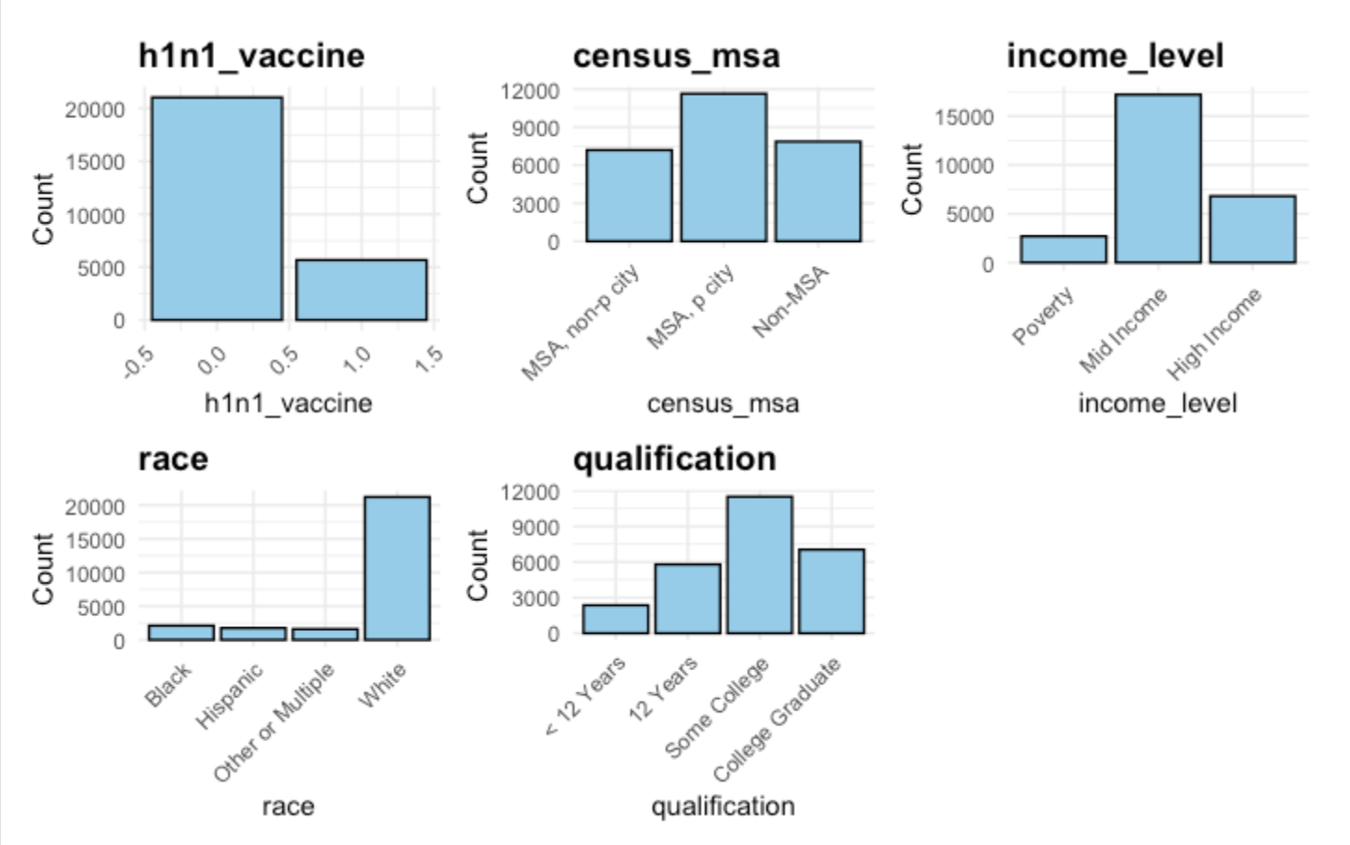
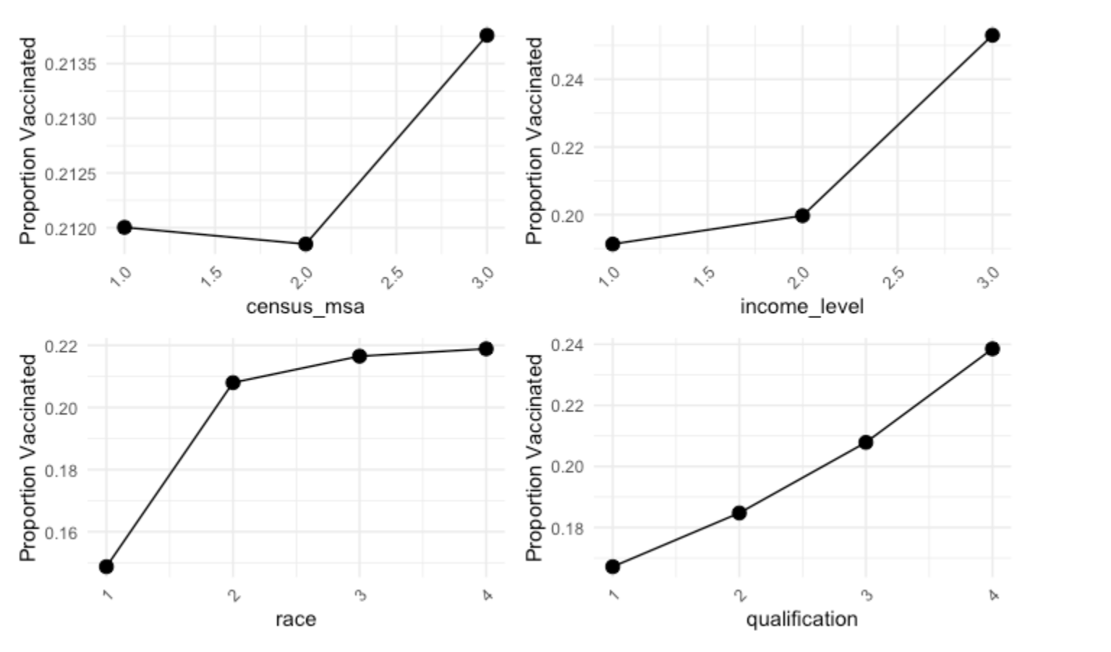
Exploratory Data Analysis
Content

Slide 8
Feature Selection
A univariate logistic regression was performed for each feature independently. The p-value for each feature was extracted from the regression model summary.
Features with a p-value < 0.05 were selected

Slide 9
Statistical Analysis

Slide 10
Models to Consider
Census_MSA as Group-Level Intercept in a Hierarchical Model
Qualification as Group-Level Intercept in a Hierarchical Model

Slide 11
Why Focus on Qualification?
The bar plot shows that individuals are distributed across different education levels with the highest count in the "College Graduate" group.
Education is a well-documented factor influencing health behavior, including vaccination decisions.
Why Focus on Census MSA?
The bar plot shows that individuals are distributed among three distinct geographic groups: "MSA, Non-Principal City," "MSA, Principal City," and "Non-MSA."
Geographic location reflects access to healthcare services and exposure to public health campaigns, which likely influence vaccination rates.
PS: MSA means “Metropolitan Statistical Area”

Slide 12
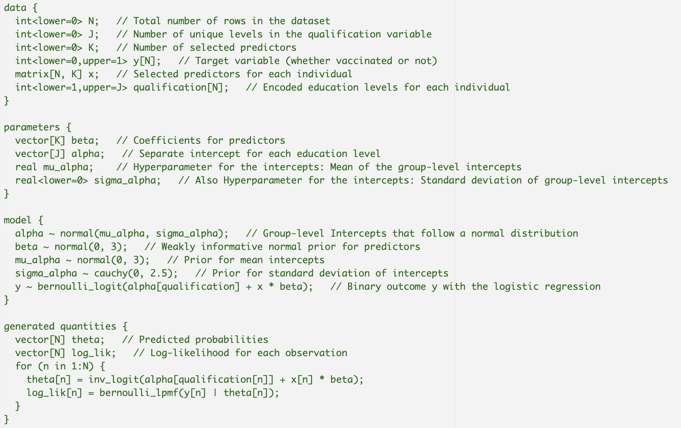
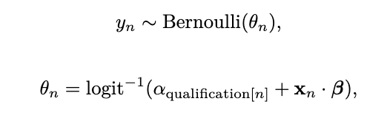
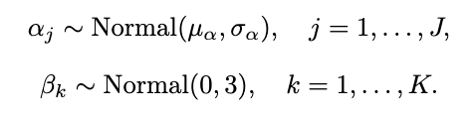
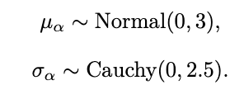
Hierarchical Model Structure
Likelihood
Prior
Hyperpriors

Slide 13
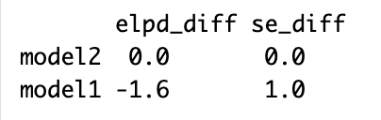
Leave-One-Out Cross-Validation
LOO is a resampling technique that removes one data point at a time, fits the model on the remaining data, and predicts the held-out point.
Model 2 (census_msa) has slightly better predictive accuracy than Model 1 (qualification). However, since 0 is included in the 95% confidence interval, we fail to reject that there is a significant difference between two models. At this stage, we go with census_MSA model.

Slide 14
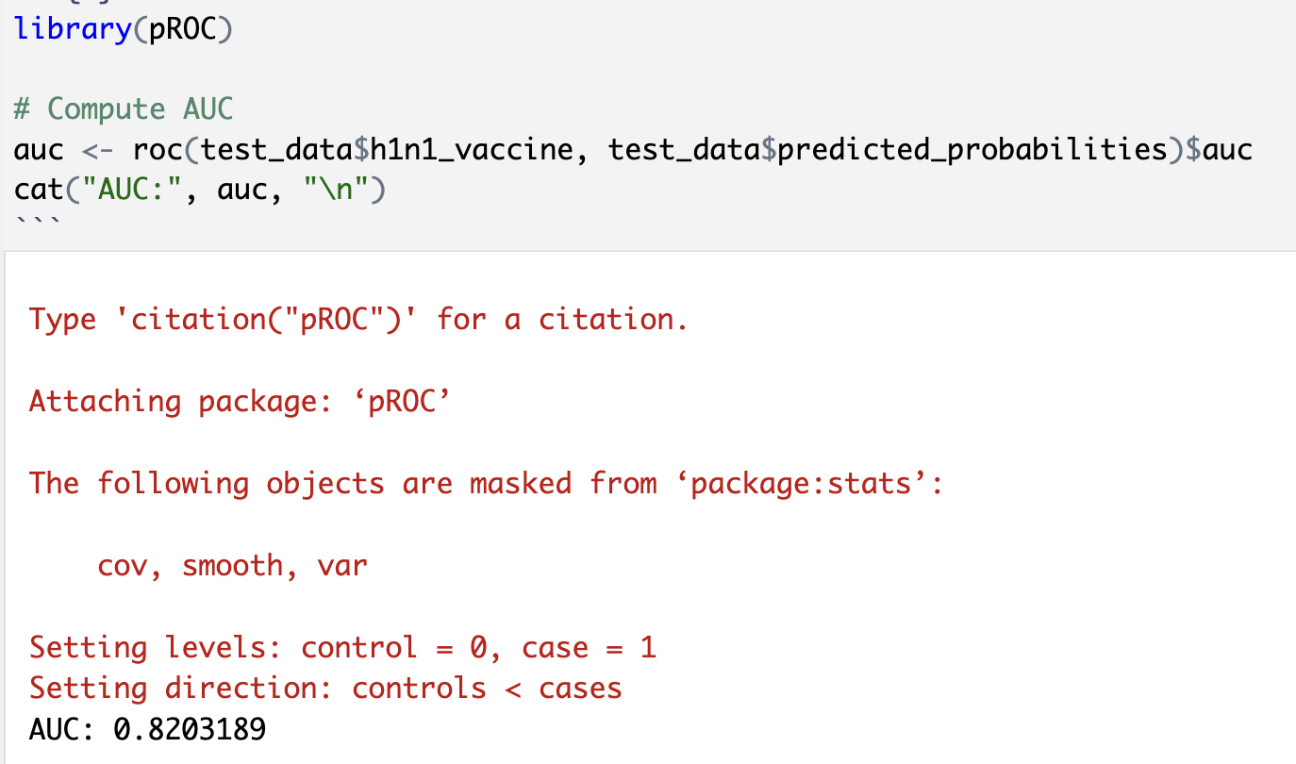
AUC
Our chosen model achieves an AUC of 0.82, indicating strong predictive performance.

Slide 15
Results & Interpretation

Slide 16
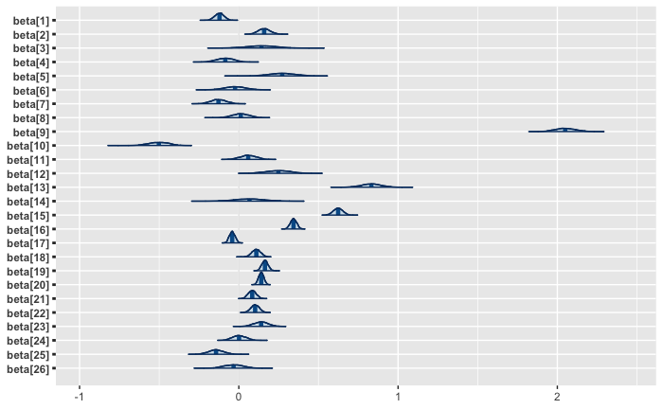
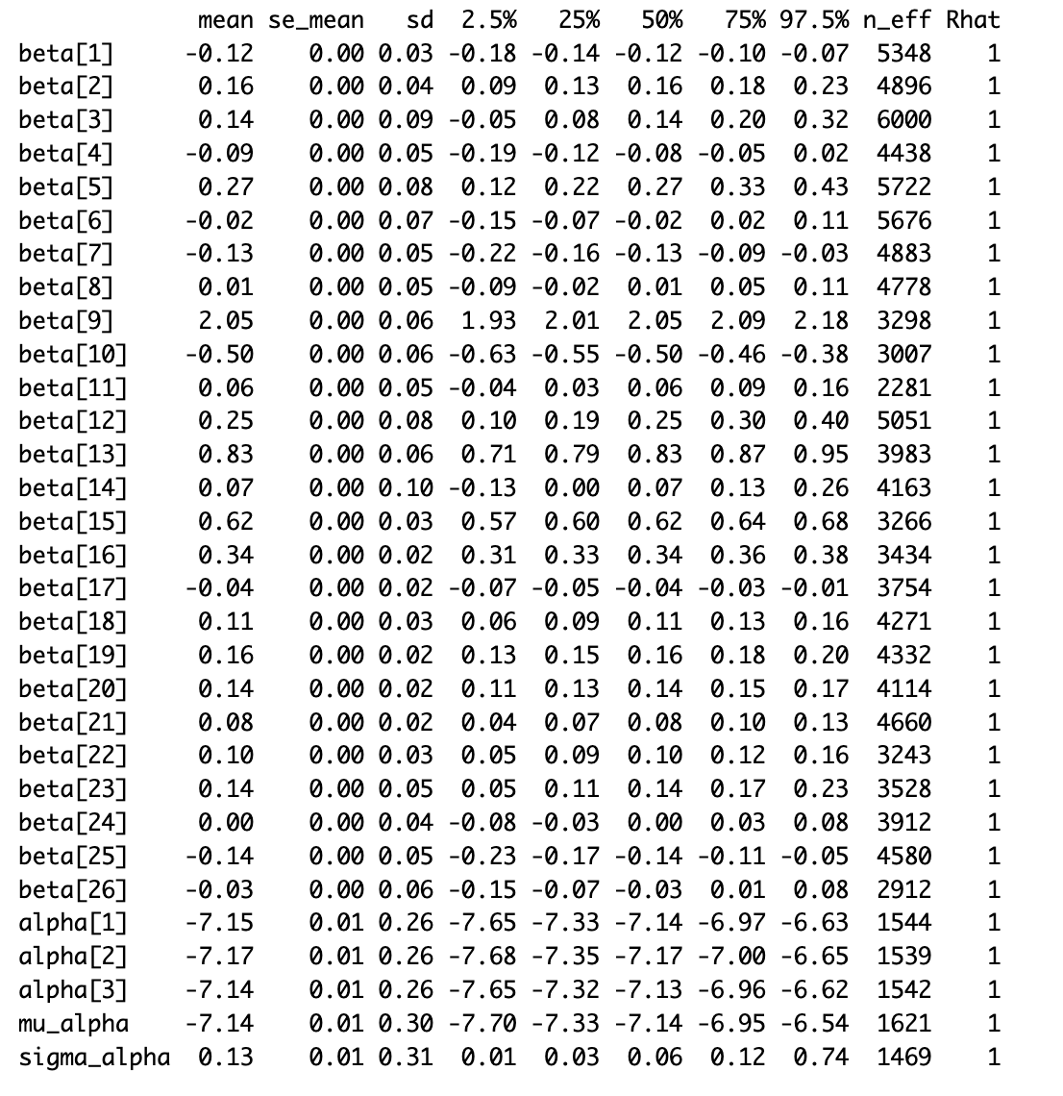
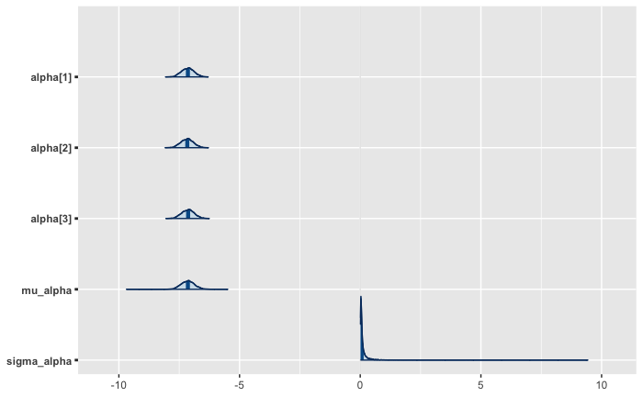
dr_recc_h1n1_vacc (Beta 9): A strong recommendation from a doctor is highly predictive of vaccination behavior, as it directly influences trust and compliance with medical advice.
is_health_worker (Beta 13): Being a healthcare worker is associated with higher vaccination rates due to greater exposure risk and better access to vaccines, making it a significant predictor.

Slide 17
Result & Next Steps
The hierarchical Bayesian model effectively captures the layered structure of H1N1 vaccination behavior, accounting for variations across demographic and different educational background groups.
Next Steps
Evaluate predictive performance against more different group-level intercepts.
Investigate alternative modeling techniques, including machine learning methods, to enhance prediction accuracy and scalability.

Slide 18
Thank you

